Slide 1
Week 2 Algorithm Projects

Slide 2
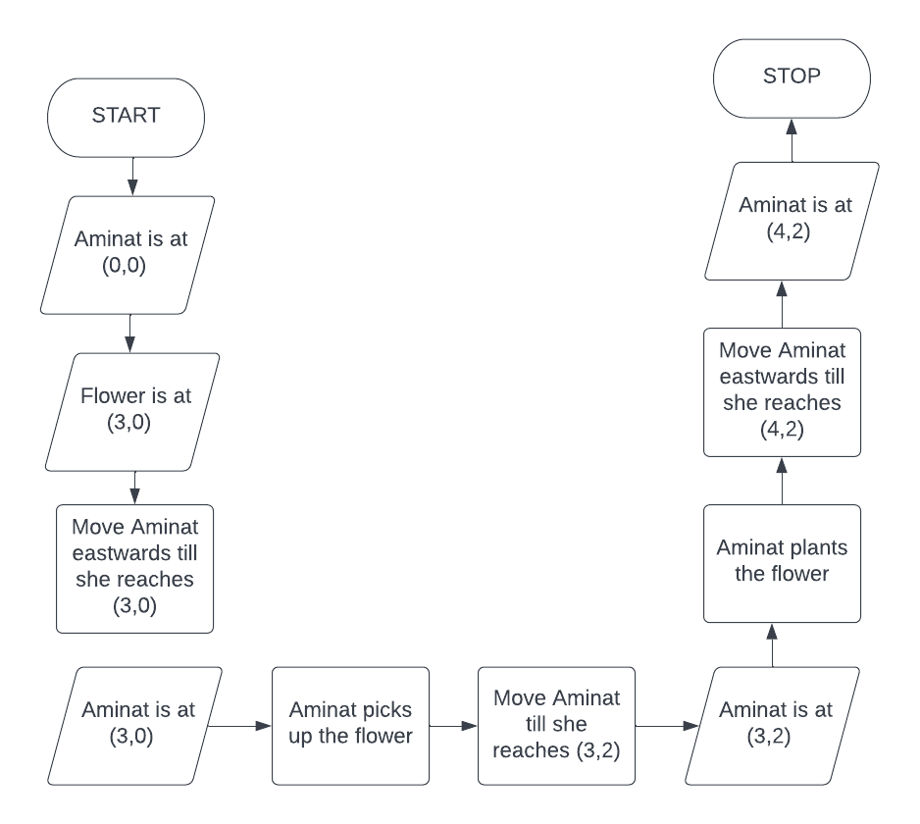
Project I
BEGIN
PLACE aminat at (0,0)
PLACE flower at (3,0)
MOVE aminat to (3,0)
SHOW "Aminat has the flower"
MOVE aminat to (3,2)
PLACE flower at (3,2)
MOVE aminat to (4,2)
END

Slide 3
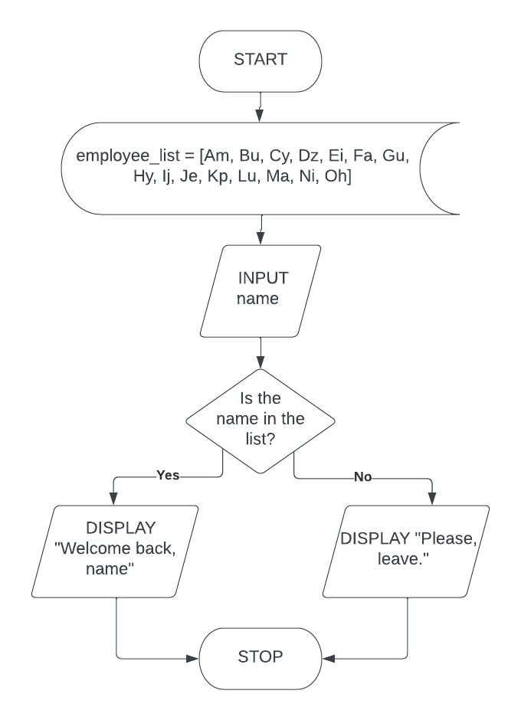
Project II
BEGIN
DECLARE employee_list = [Am, Bu, Cy, Dz, Ei, Fa, Gu, Hy, Ij, Je, Kp, Lu, Ma, Ni, Oh]
INPUT name
IF name is in employee_list:
DISPLAY "Welcome back, name"
ELSE:
DISPLAY "Please, leave."
END

Slide 4
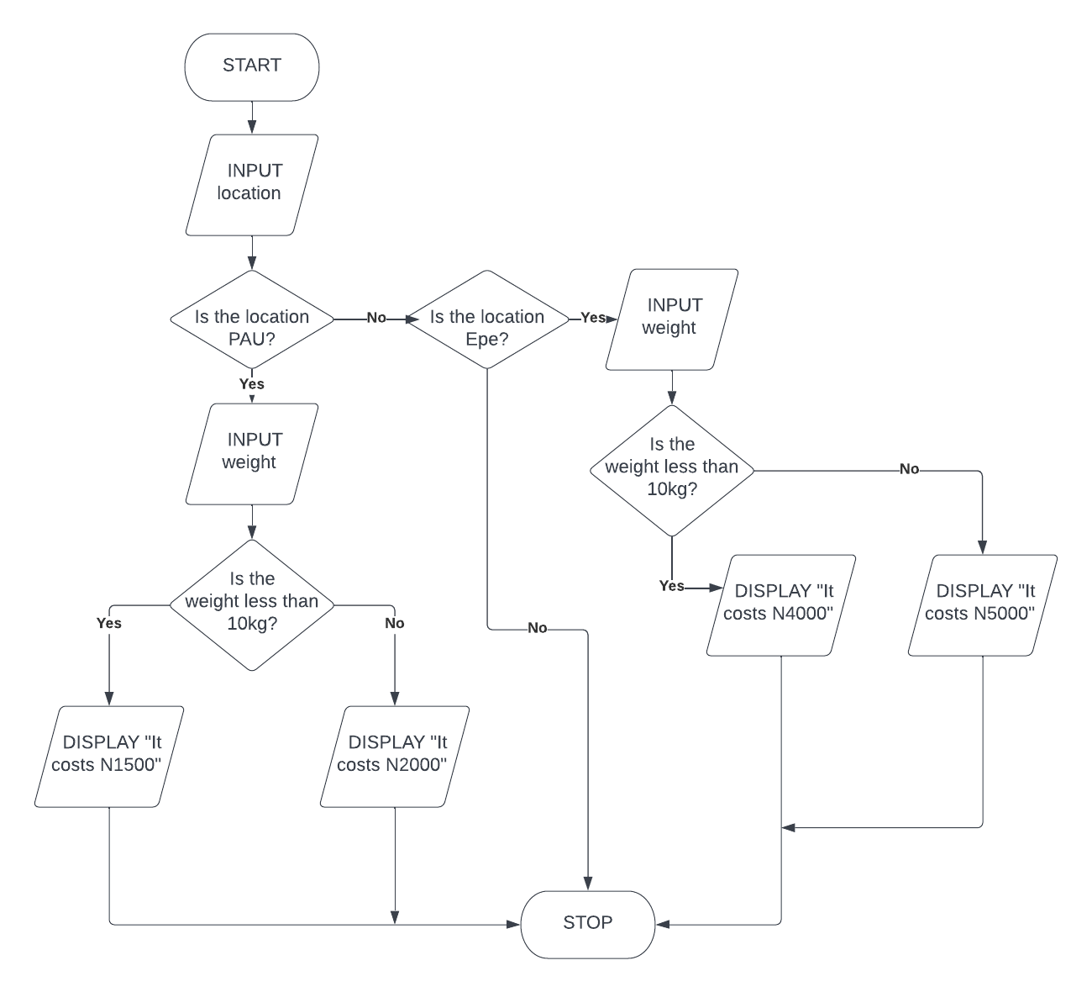
Project III
BEGIN
INPUT location
IF location = PAU:
DISPLAY "What is the package weight?"
INPUT weight
IF weight < 10:
DISPLAY "It costs N1500"
IF weight = 10:
DISPLAY "It costs N2000"

Slide 5
IF weight > 10:
DISPLAY "It costs N2000"
IF location = Epe:
DISPLAY "What is the package weight?"
INPUT weight
IF weight < 10:
DISPLAY "It costs N4000"
IF weight = 10:
DISPLAY "It costs N5000"
IF weight > 10:
DISPLAY "It costs N5000"
END

Slide 6
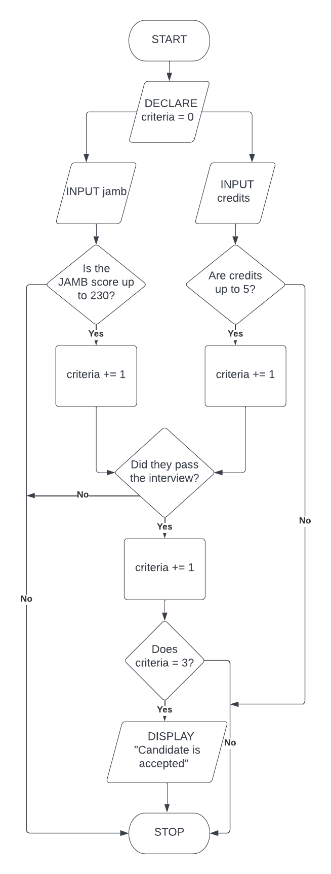
Project IV
BEGIN
DECLARE criteria = 0
INPUT jamb
IF jamb >= 230:
DISPLAY "The student meets the JAMB criteria"
criteria +=1
INPUT credits
IF credits >= 5:
DISPLAY "The student meets the credits criteria"
criteria +=1

Slide 7
INPUT interview
If interview = Yes:
DISPLAY "The student passed the interview"
IF criteria = 3:
DISPLAY "The student is admitted"
END

Slide 8
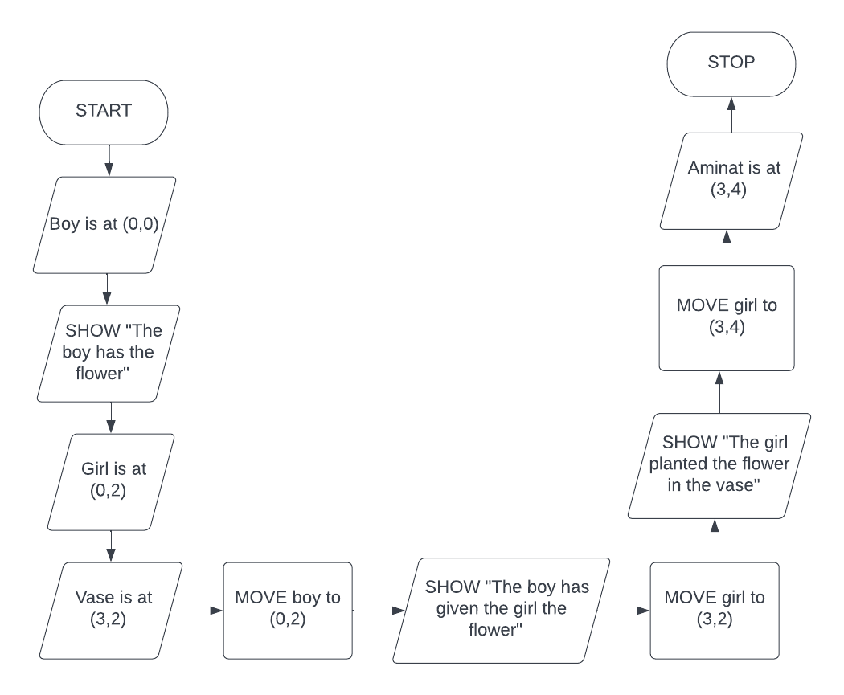
Project V
BEGIN
PLACE boy at (0,0)
SHOW "The boy has the flower"
PLACE girl at (0,2)
PLACE vase at (3,2)
MOVE boy to (0,2)
SHOW "The boy has given the girl the flower"
MOVE girl to (3,2)
SHOW "The girl planted the flower in the vase"
MOVE girl to (3,4)
END

